Slide 1
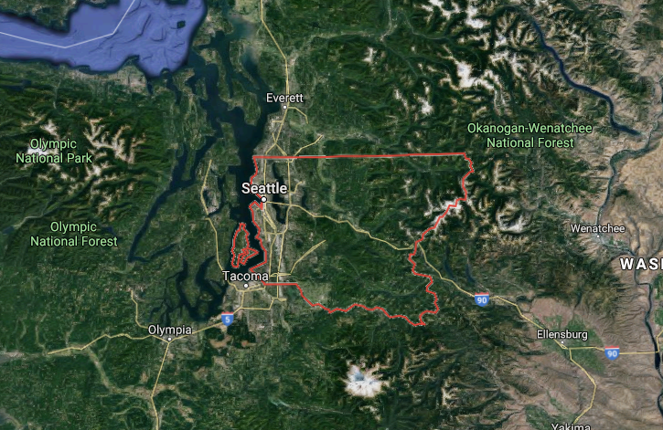
What impacts Houses Prices in King County? What can you do to increase the value you of your property?
Image Source: Google maps
Tara Mullin, Flatiron Part-Time Data Science Bootcamp
Notes:
* **Goal** : Predict the housing prices based on features in the dataset, understand how factors influence price to determine which are most impactful* business stakeholders: how much/how many? which category? which group?#1) Understand the problem. Look at each variable and perform analysis to their understand importance for the goal#2) Univariable study. focus on the dependent variable ('price') to try to know a little bit more about it#3) Bivariate and multivariate study. analyze how the dependent variable and independent variables relate

Slide 2
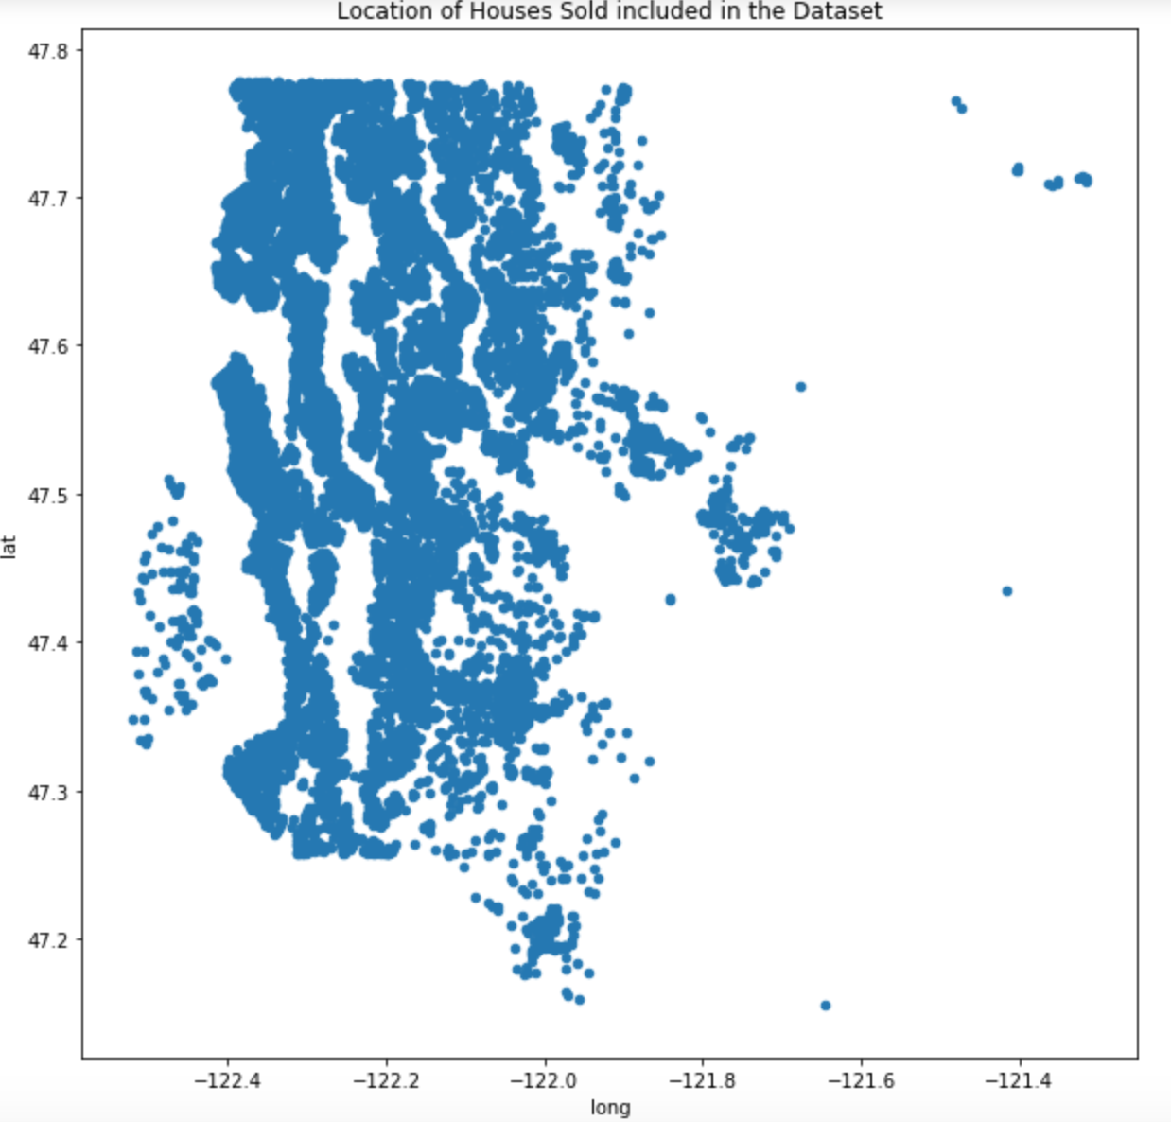
Background
21,142 houses
Average price = $540,506
Average size = 2,080 sqft
Initial Hypotheses:
Location
Quality
Size
Features
Year built

Slide 3
Methodology
Understand & Prepare the data
Explore the data
Model the data
Technique: Multiple regression
Interpret results

Slide 4
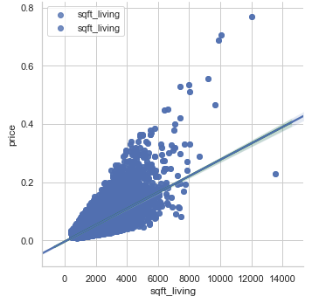
Results : Size
Square Footage of House
50% larger house → costs 27% more
a house that is twice as large → costs 54% more
Square Footage of Lot
50% larger lot → costs 8% more
a lot that is twice as large → costs 16% more

Slide 5
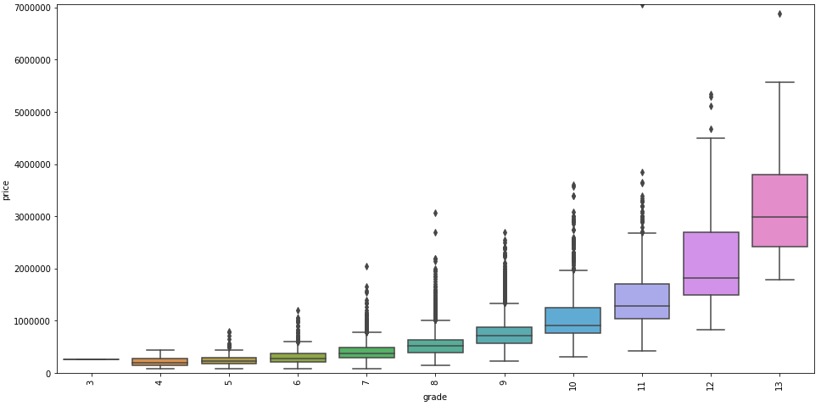
Results : Quality
Grade Rating
One grade higher → costs 28% more

Slide 6
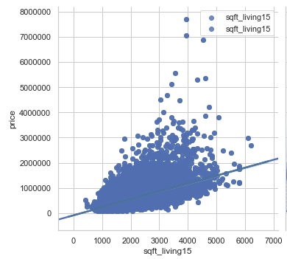
Results : Neighborhood
Square Footage of 15 Closest Neighbors
Neighboring houses 50% larger → costs 11% more
Neighboring houses twice as large → costs 21% more

Slide 7
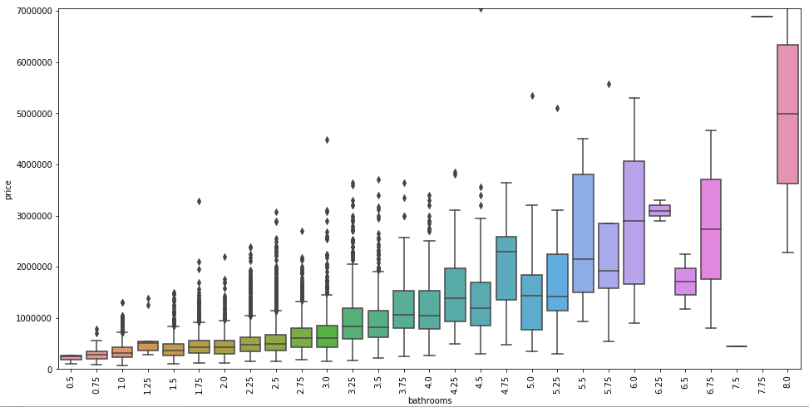
Results : Features
Number of Bathrooms
1 bathroom added → costs 14% more

Slide 8
Summary
Most important factors for house price:
Size
Quality
Neighborhood
Features, specifically bathrooms

Slide 9
Recommendations
To increase the value of your home:
Renovate to increase square footage
Renovate existing and new spaces with high quality materials to increase the grade
Add a bathroom

Slide 10
Limitations & Future Work
Limitations:
Most accurate for 2-5 bedrooms & 0.75 – 3.5 bathrooms
Can’t predict the price of waterfront properties
Future work:
Research ‘grade’
Further investigate location variables – latitude, longitude, & zipcode
Explore year built and it’s relationship to year renovated

Slide 11
Thank you!
Questions?

